Slide 1

SAP Cloud Platform ABAP Environment
Product Management SAP Core Platform
July, 2019

Slide 3
TABLE OF CONTENTS
WHY SAP Cloud Platform?
WHY ABAP in SAP Cloud Platform?
SCENARIOS for SAP Cloud Platform ABAP Environment
ROADMAP for SAP Cloud Platform ABAP Environment

Slide 4
Why SAP Cloud Platform?

Slide 5
Managing your digital transformation with SAP’s Digital Enterprise Platform
AGILE LAYER Differentiate Your Business
SAP SOLUTIONS
SAP CLOUD PLATFORM
Digital
Transformation
NEW
DIGITAL CORE Optimize Your Core Processes
Agile
Business
Optimized
Enterprise
DATA AS YOUR FOUNDATION

Slide 6

Extensibility with SAP Cloud Platform
INNOVATIONS
from SAP HANA and SAP Cloud Platform
DE-COUPLING
Side-by-side approach adds flexibility for upgrades and custom / partner driven innovation
DEVELOPMENT PRODUCTIVITY
High development productivity based on tools, re-use of business services and first class integration with SAP solutions
AGILITY & RELEASE STRATEGY
Start today on SAP Cloud Platform and connect to multiple backend releases

Slide 7











When to use what?
Your developers skillset
Your software assets
Your scenarios and use-cases
DECISION CRITERIA
ABAP
Java
Node.js and HTML5
BYOL
ABAP
Java and the Java logo are registered trademarks of Oracle and/or its affiliates.

Slide 8
Why ABAP in SAP Cloud Platform?

Slide 9



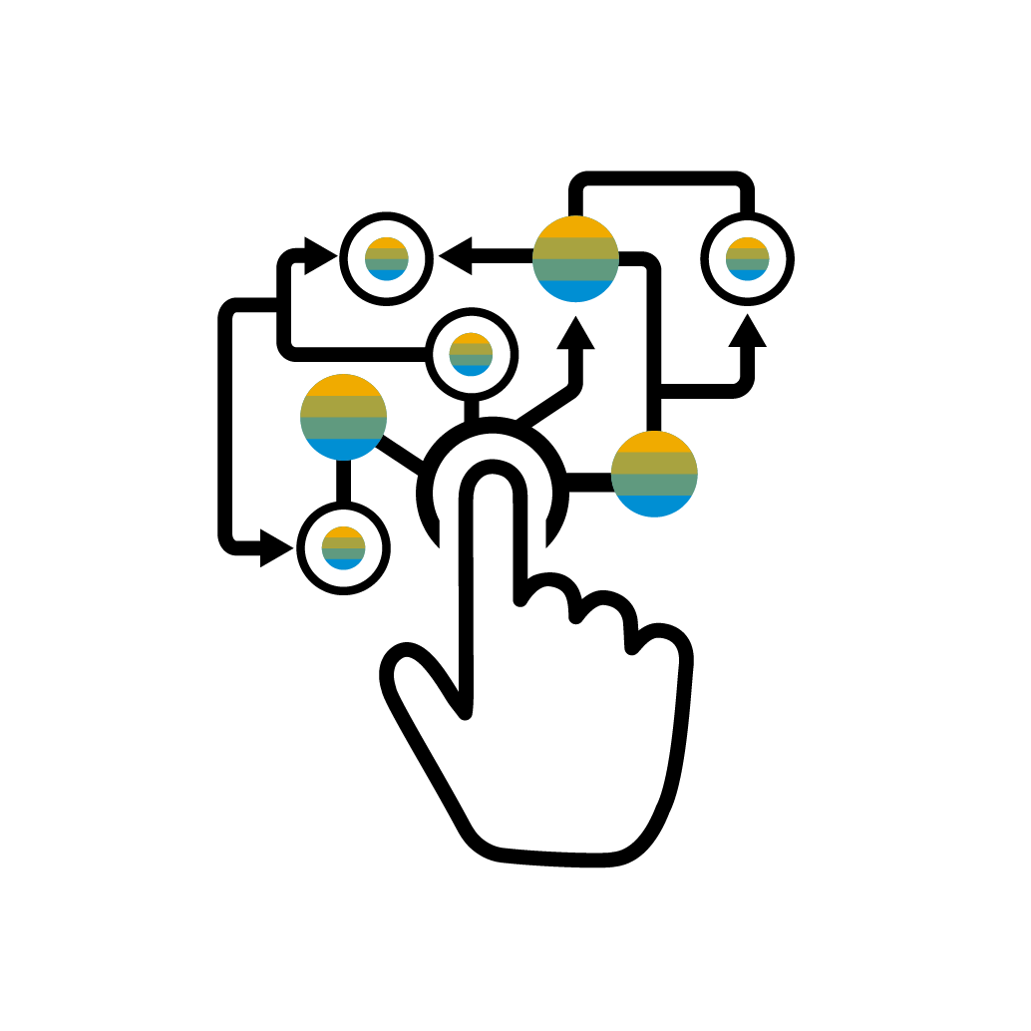
WHY ABAP IN SAP CLOUD PLATFORM?
TRANSFORMATION TO CLOUD
MARKET OPPORTUNITIES FOR PARTNERS
AGILE INNOVATION ON NEWEST TECHNOLOGY POWERED BY SAP HANA
DELEGATE INFRASTRUCTURE AND SYSTEM OPERATIONS

Slide 10
SAP CLOUD PLATFORM ABAP ENVIRONMENT MAIN USE CASES
TRANSFORMATION TO CLOUD
MARKET OPPORTUNITIES FOR PARTNERS
Develop ABAP cloud apps decoupled from the digital core
Leverage your ABAP know how in the cloud
Reuse your existing ABAP assets
Commercialize your apps via SAP Cloud Platform
Benefit from large SAP customer base
Network with ABAP community

Slide 11
AGILE INNOVATION ON NEWEST TECHNOLOGY POWERED BY SAP HANA
DELEGATE INFRASTRUCTURE AND SYSTEM OPERATIONS
Benefit from newest ABAP Programming Model
Exploit SAP HANA capabilities
Consume SAP Cloud Platform services like SAP Leonardo
SAP CLOUD PLATFORM ABAP ENVIRONMENT MAIN USE CASES
Regular delivery of innovations by SAP
Scale with your business needs
Support for multiple cloud providers Pay per use

Slide 12
Vital parts of SAP Cloud Platform ABAP Environment
SAP CLOUD PLATFORM
SAP FIORI SERVICES
CLOUD COCKPIT
BACKEND SYSTEM
e.g. SAP S/4HANA Cloud, SAP S/4HANA, SAP ERP, SAP NetWeaver AS ABAP
ABAP PLATFORM AS A SERVICE
ABAP DEVELOPMENT TOOLS IN ECLIPSE
HTTP SERVICES AND NEW RESTful ABAP PROGRAMMING MODEL utilizing
Core Data Services
Cloud optimized ABAP language
SERVICES ECOSYSTEM
User Management
Internet of Things
Document Management
Machine Learning
…
EXTERNAL HTTP SERVICE
GIT CODE MANAGEMENT
SAP HANA

Slide 13




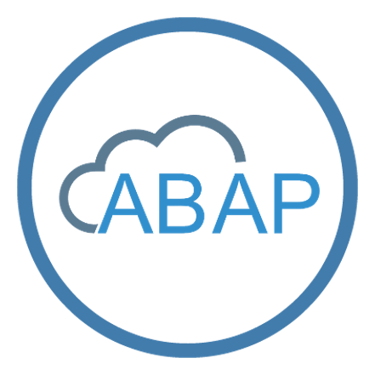






Vital parts of SAP Cloud Platform ABAP Environment
Services Ecosystem
SAP Fiori Cloud
SAPUI5
User Management
SAP Cloud Platform cockpit
Internet of Things
ABAP Environment
HTTP services and new RESTful ABAP programming model utilizing
Core Data Services
Cloud optimized ABAP language
Backend System
for example SAP S/4HANA Cloud, SAP S/4HANA, SAP ERP, SAP NetWeaver AS ABAP
Document Management
ABAP Development Tools in Eclipse
Machine Learning
External HTTP service
Git Code Management
SAP HANA database

Slide 14
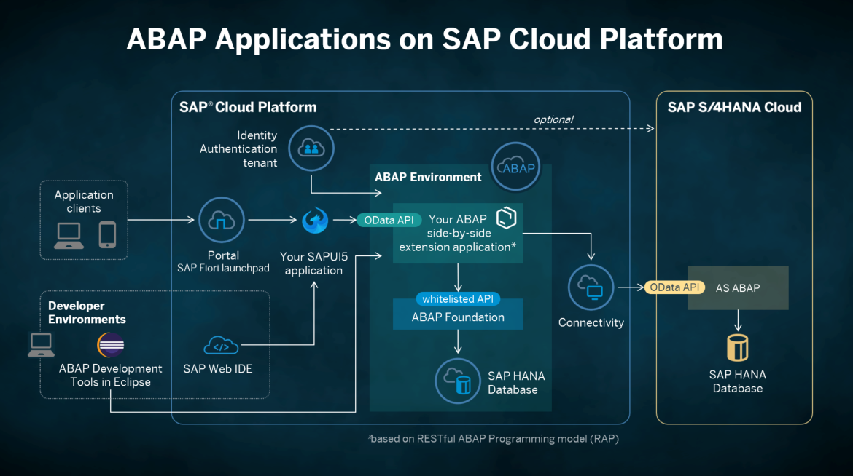

Slide 15
Evolution of the ABAP programming model
ABAP Platform ≤ 7.5
ABAP Platform ≥ 7.5
SAP Cloud Platform ABAP Environment ≥ 1808 *
CLASSIC ABAP PROGRAMMING
ABAP PROGRAMMING MODEL FOR SAP FIORI
ABAP RESTful PROGRAMMING MODEL
SEGW / @OData Referenced Data Source
Business Service
Best practice freestyle ABAP programming
Core Data Services (CDS)
CDS-based BOPF
Core Data Services
Behavior Definition & Implementation
Dos and Don’ts
Be prepared for the new programming models
Current best practice in SAP S/4HANA
Recording from SAP TechEd 2017
Documentation
Future direction
Today’s session
Documentation
Safe investments! Integration planned for 2020
* Reduced scope available on-premise as of SAP S/4HANA 1909

Slide 16

ABAP RESTful Programming Model – The key players
ABAP Development Tools in Eclipse for all development tasks
Easy developer onboarding End-to-end development flow
Language: ABAP and CDS
Standard implementation tasks via typed APIs supporting static code checks, auto-completion, element info
Frameworks
Take over technical implementation tasks Business logic added in code exits on protocol agnostic layers

Slide 17


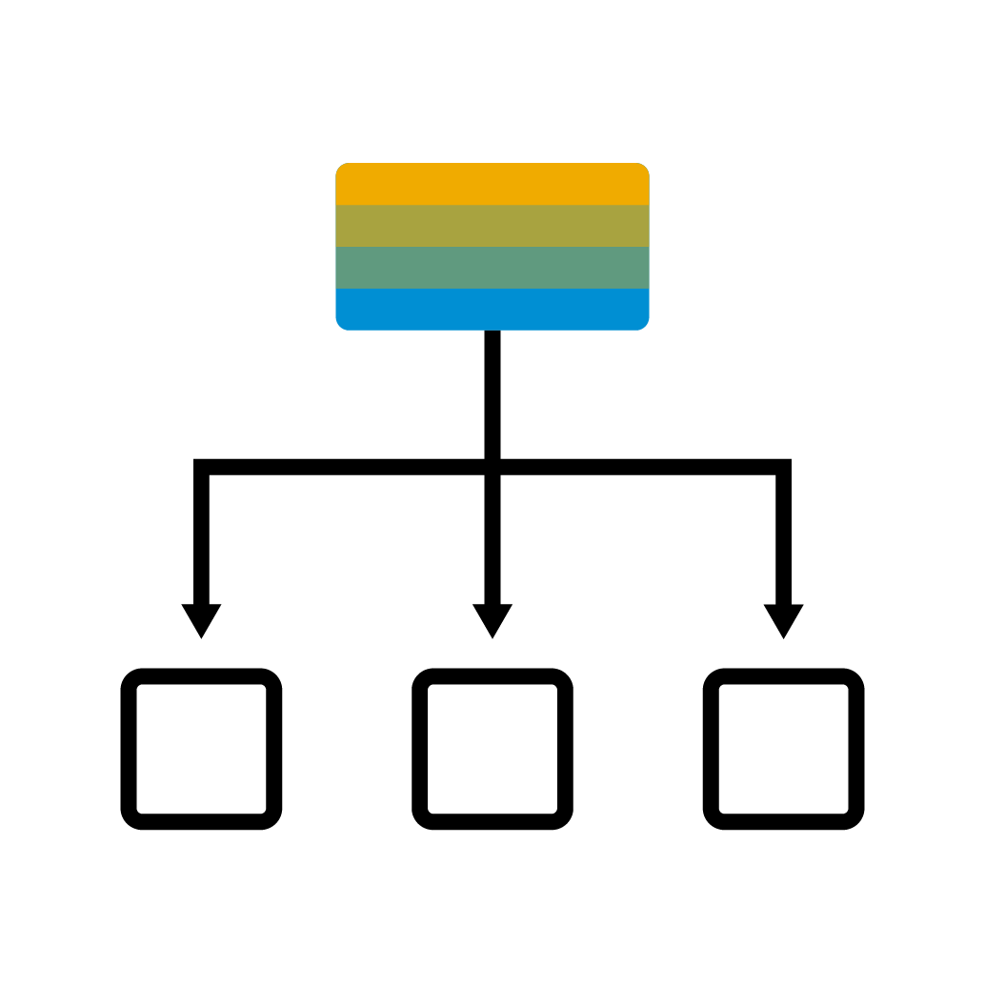


ABAP RESTful Programming Model – The big picture
SERVICE CONSUMPTION
SAP Fiori UI Consume OData UI services
Web API Consume OData Web APIs
SERVICE BINDING Bind to protocol version and scenario
BUSINESS SERVICES PROVISIONING
SERVICE DEFINITION Define scope to be exposed
CDS: Projection Views
BDEF: Behavior Projection
BUSINESS OBJECTS
QUERIES
CDS: Data modeling
DATA MODELING & BEHAVIOR
CDS: Data modeling
BDEF: Behavior definition
ABAP: Behavior implementation

Slide 18
Scenarios for SAP Cloud Platform ABAP Environment

Slide 19




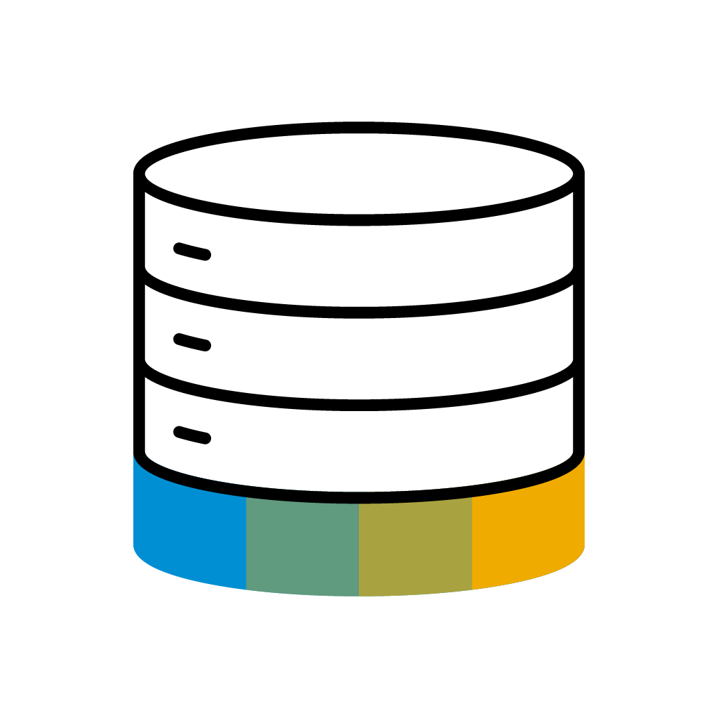

Scenario 1: Side-by-side Extensibility for SAP S/4HANA Cloud
SAP CLOUD PLATFORM
Your ABAP extension
SAP S/4HANA CLOUD
OData
Application Clients
Connectivity
Custom Data SAP HANA tenant
Corporate Identity Provider

Slide 20
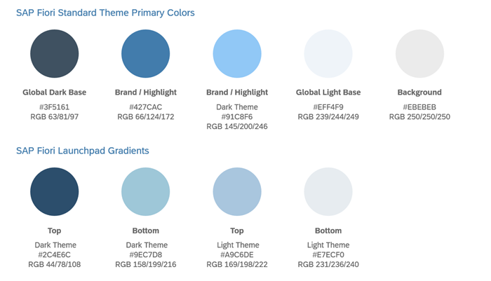






Vital parts of SAP Cloud Platform ABAP Environment Diagram Variant C: more detailed
ABAP Environment
Application Clients
Your ABAP Extension
OData API
Connectivity
Custom Data SAP HANA instance
Corporate Identity Provider

Slide 21


Scenario 2: Partner side-by-side apps (SaaS scenario)
Partner
SAP CLOUD PLATFORM
commercialization
SAP S/4HANA CLOUD
Your ABAP extension
deployment
Connectivity
Custom Data SAP HANA tenant
SAP App Center

Slide 22


Scenario 2: Partner side-by-side apps (SaaS scenario)
deployment
Your ABAP Extension
SAP App Center
Connectivity
Custom Data SAP HANA instance

Slide 23




Transformation of existing custom code to SAP Cloud Platform ABAP Environment
DECOUPLE CUSTOM CODE FROM SAP APPLICATION CODE
USE SAP CLOUD PLATFORM SERVICES
ADOPT NEW RESTful ABAP PROGRAMMING MODEL
MANAGE DEVELOPMENT PROCESS AND DEPLOYMENT
ELIMINATE USE OF DEPRECATED ABAP FUNCTIONALITY
UTILIZE PARTNER ECOSYSTEM

Slide 24
Thank you.
Contact information:
Product Management Frank Jentsch, Jürgen Remmel, Florian Wahl
frank.jentsch@sap.com
juergen.remmel@sap.com
florian.wahl@sap.com

